Slide 2
Managing the Evolving Insurance Landscape
Tim H. Delaney
Lancer Insurance
Matt Daus
Windels Marx
Andrew Don
Research Underwriters
Moderator: Jason Sharenow
Broadway Elite Worldwide
Audio Visual
Sponsor
Coffee Sponsor

Slide 3
Welcome & Thank You to Our Sponsors
Coffee Sponsor
Audio Visual Sponsor

Slide 4
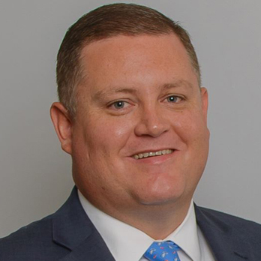
Managing the Evolving Insurance Landscape
Tim H. Delaney
Lancer Insurance
Audio Visual
Sponsor
Coffee Sponsor

Slide 5
156 Insurance Companies Gone
Acceleration National Insurance Co.
Acceptance Insurance Company
Accident Insurance Company
Aegis
Aequicap Insurance Company
AIG
American Alternative
American National Insurance Co.
American Reliable
American Transportation Group
AmGUARD Insurance Company
Arch Insurance Company
Argonaut Insurance Company
Aries
Associated International
Associates Insurance Company
Athena
Atlantic Mutual
Atlas Financial
AXA
Balboa Insurance Company
Baldwin Sadler
Berkshire Hathaway Homestate Ins. Co.
Berkshire Hathaway Specialty Ins.
Brookwood Insurance Company
Calvert
Capital Mutual
Carolina Casualty Insurance Co.
Castlepoint Florida Insurance Co.
Castlepoint Insurance Co.
Cherokee Insurance Co.
Chubb National
Clarendon National Insurance Co.
CNA
Columbia Insurance Company
Commerce & Industry Insurance Co.
Connecticut Specialty
Continental Casualty Co. (C.N.A.)
Continental Casualty Company
Continental Divide Insurance Company
Continental National
Continental Western Insurance Co.
Coonia
County Hall Insurance Company
Credit General
Crum and Forster
Delos Insurance Company
Diamond State Insurance Company
Dubuque Fire & Marine
Empire Fire & Marine Insurance Co.
Endurance American Insurance Co.
Everest National Insurance Company
Excalibur Insurance Company
Falcon Insurance Company
Falls Lake National Insurance Co.
Fidelity and Guaranty Insurance Co.
Fireman’s Fund Insurance Company
First Acceptance Insurance Company
Frontier Insurance Company
GAINSCO
Gateway Insurance Company
General American
General Security Insurance Company
Generali Insurance Company
Global Hawk Insurance Company
Global Liberty
Gramercy Insurance Company
Granite State Insurance Company
Great American Insurance Company
Great Divide Insurance Company
GuideOne Property & Casualty
Gulf Insurance Company
Hallmark Insurance Company
Hannover Re Insurance Company
Hanover Insurance Company
HarCo. National Insurance Company
Hartford Casualty Insurance Co.
Hartford Fire Insurance Company
Heritage Mutual
Highlands
Home Indemnity Company
Homestate/NY Merchant Bakers
ICW
Illinois National Insurance Co.
INA/Cigna
Indian Harbor Insurance Co.
Inscorp
Insurance Co. of the State of PA
Integon Indemnity Corp.
Intercargo
Interity Insurance Company
International Indemnity
James River Insurance Company
Jefferson Insurance Company
John Deere Insurance Company
Knight Specialty Insurance Company
Knightbrook Insurance Company
Legion Insurance Company
Liberty Mutual Insurance Company
Lincoln General Insurance Company
Lincoln National
MAPFRE Insurance Company
Maxum Casualty Insurance Co.
Maxum Indemnity Company
Meadowbrook Insurance Company
Mercury Insurance Co.
Millers Mutual
National American Insurance Co.
National Fire & Marine Insurance Co.
National General Insurance Co.
National Indemnity Company
Nationwide
New Jersey Manufacturers Ins. Co.
New York Marine & General Ins. Co.
Nobel Insurance Company
Northland
Nova Casualty Company
Oak River Insurance Company
Old Republic
One Beacon
Peerless Insurance Company
Praetorian Insurance Company
Progressive
Property & Casualty Ins. Co. of Hartford
Protective
Providence Washington Insurance Co.
QBE Insurance Corp
Redland Insurance Company
Redwood Fire and Casualty Ins. Co.
Reliance Insurance Company
Republic Western Insurance Company
RLI Insurance Company
Security National Insurance Co.
Selective Insurance Company
Sirius American Insurance Co.
Sparta Insurance Company
Spirit Commercial Auto Insurance Co.
St. Paul
Starr Indemnity & Liability Ins. Co.
Stratford Insurance Company
T.H.E. Insurance Company
Transamerica
Transit Casualty Insurance Company
Transport Insurance Co.
Transportation Casualty Ins. Co.
Travelers
United Fire & Casualty
United National Insurance Company
United Public Insurance Company
USF&G
Utica Mutual Insurance Company
Vanliner Insurance Company
Wausau
Westfield Insurance Company
Westport Insurance Company
Zurich American Insurance Company

Slide 6
AGENDA
Introduction
Commercial Auto Insurance: Macro View
Why Are Claims Getting More Expensive?
What Can We Do to Fight Back?
Technology Themes
Planning Ahead for the Long Term
Audio Visual
Sponsor

Slide 7
COMMERCIAL AUTO INSURANCE – MACRO VIEW
Commercial Auto – Net UW losses 2013-2023
Commercial Auto 2023 incurred $5B loss (AM Best)
Combined ratio 2023 – 109.2%
First 6 months of ‘24 trending worse than ‘23
Overall Commercial lines experience is strong
Liability most troubled, especially older years
Average loss per liability claim doubled since 2014
Economic and social inflation
Rate vs. loss cost inflation
Venue differences
Audio Visual
Sponsor

Slide 8
WHY ARE CLAIMS COSTS RISING?
Distracted Driving: Cars themselves are more distracting, smartphone use in vehicles and pedestrians, hands-free not as safe as many believe due to attention load
Litigation & Medical Financing
Increasing Medical Costs & New Science: TBIs, spinal, & other surgeries
Decline of Driving as a Career
Fatigued Driving: Sleep apnea, medications, stress
Aging Driver Pool
Low Unemployment
Road Congestion and Infrastructure Disrepair
Raised Speed Limits
Audio Visual
Sponsor

Slide 9
WHY ARE CLAIMS COSTS RISING? (PT. 2)
Drastic increase over time of claimants represented by attorneys
Rise of national plaintiff brands and specialist attorneys
Reptile Theory: trial strategy that attempts to activate jurors’ “survival mode” to award excessive damages
Legalization/decriminalization of marijuana (CO and WA had macro-frequency upticks)
Increased Publicity: Adverse events including accidents, verdicts, driver criminal charges getting immense publicity on the internet, creating an impression of an unsafe industry
Value of Money: Mega-lotteries, verdicts, athlete salaries, “billions”… The public has grown disconnected from real economic value
Tariffs?
Audio Visual
Sponsor

Slide 10
WHAT CAN WE DO TO FIGHT BACK?
Choose your insurance partners carefully!
Be an open book & utilize all resources
Build direct relationships where possible
A culture of safety is measurable & imperative
The cheapest claim is the one prevented
Cameras at a minimum
Technology tools to help managers
Share risk prudently
Audio Visual
Sponsor

Slide 11
EMBRACE TECHNOLOGY & DEVELOP A PLAN
Cameras/Video Advantages & Limitations
Telematics/Fleet Management Systems
Evolution of Driver Scoring and/or Incentives
Data Analytics & Predictive Insights
Electric & Autonomous Vehicles
AI Everything
Audio Visual
Sponsor

Slide 12
PLAN FOR YOUR NEXT RENEWAL TODAY
Have open and honest conversations with your insurance broker to understand what to expect for your next renewal
Set aside expected insurance increases in your annual budget
Create ways to communicate insurance increases to your customers
Audio Visual
Sponsor

Slide 13
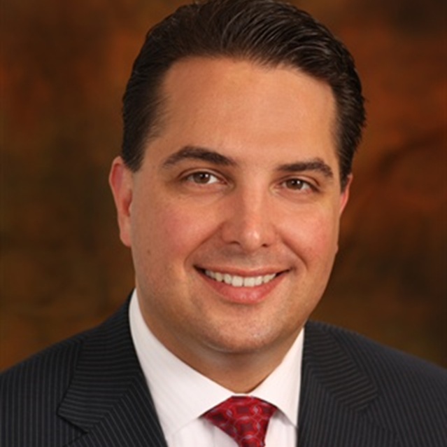
Managing the Evolving Insurance Landscape
Matt Daus
Windels Marx
Audio Visual
Sponsor
Coffee Sponsor

Slide 14
Matthew W. Daus, Esq.
Former Commissioner/Chair/CEO & General Counsel, New York City Taxi & Limousine Commission
President, International Association of Transportation Regulators (since 2009) iatr.global
Transportation Technology Chair, University Transportation Research Center, City University of New York at The City College of NY utrc2.org
Partner, Chair & Founder of Transportation Practice Group, Windels Marx Lane & Mittendorf, LLP windelsmarx.com
Contact: mdaus@windelsmarx.com or 646.261.1590
Audio Visual
Sponsor

Slide 15
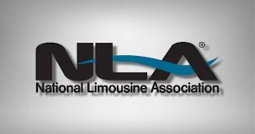
New Report – Curbing the Limousine Insurance Crisis: For-Hire Vehicle Insurance Reform
UTRC is preparing a report on the for-hire insurance system and reform measures
Methodology:
NLA member survey to identify issues, root causes, and possible solutions
Interview and consult with state limousine associations to identify the local challenges and assess the political landscape for insurance reform
Peer review by leading insurance and risk mitigation experts
Recommend a Plan of Action with short-term, mid-term & long-term solutions:
Insurance Reform: Adjusting no-fault and liability limits, rate approval process
Telematics for Risk Mitigation & Price Relief
Non-traditional innovative insurance options to stabilize premiums: Excess/surplus insurance policies, captive insurance models
Tort Reform: Reducing frivolous lawsuits to lower litigation costs and insurance premiums
Foster Competition: Attract new market players and drive down costs
Audio Visual
Sponsor

Slide 16
Where Is Insurance “So Damn High”?
Insurance premiums are increasing everywhere, including…
Maryland: Legislative changes over the past year increased insurers’ financial responsibility
Florida, Michigan, New York: “No-fault” systems speed-up claims and provide opportunities for insurance fraud
Florida, Louisiana, Nevada: Insurers face weather-related damages from hurricanes and wildfires, causing unrelated losses
Audio Visual
Sponsor

Slide 17
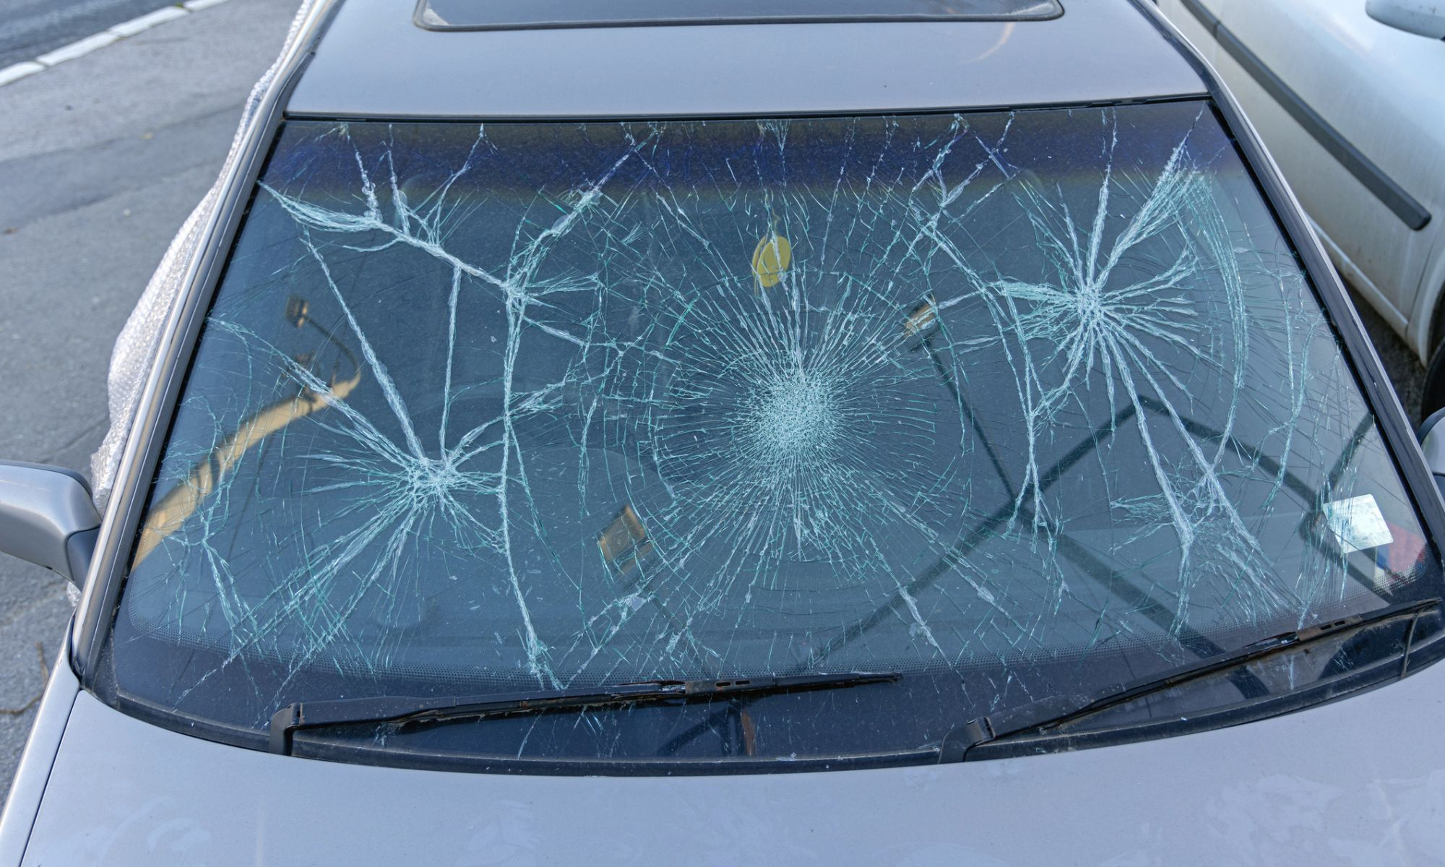
Where Else Is Insurance “So Damn High”?
Washington, D.C.: Vehicle theft 3x national average, hectic traffic patterns, traffic fatalities increased 41% 2022-23
South Carolina: Most traffic fatalities per vehicle-miles-traveled, hurricane & tropical storm risk, legislative changes increasing insurer responsibility
Colorado: Second-most vulnerable state to hail damage
Audio Visual
Sponsor

Slide 18
Root Causes of Higher Insurance Costs
Higher Claim Payouts: Larger claim sizes (severity), increase in the number of claims, and rising costs of vehicle repairs, replacement parts, medical expenses
Advanced technology and materials are most costly to repair
Litigation and Legal Costs: Rise in litigation costs, jury awards and settlements
Distracted Driving: Increased accidents from smartphone use
Impact of Inflation: Affects cost of everything from auto parts to labor = more expensive repairs and medical bills
COVID-19: Surge in reckless driving post-lockdown + more severe accidents = higher claim costs
Audio Visual
Sponsor

Slide 19
Combined Ratio
How much a carrier pays out in claims and costs compared to how much it earns from premiums
Ratio < 100% = underwriting profit
Ratio > 100% = significant underwriting losses → increased premiums
Commercial Auto averaged a combined ratio of 108% over the past 13 years and 113.3% in 2023
Insurers spent $1.13 for every $1.00 received in premiums
Audio Visual
Sponsor

Slide 20
What Can Operators Do to Reduce Costs Now?
REDUCE RISKS:
Telematics
Implement Safety Programs
Audio Visual
Sponsor

Slide 21
Deploy Telematics NOW!
Cameras and devices collect driving data
New systems can alert to the risk of a collision or distracted driving prior to the event to help prevent it
Evidence can be used to verify claims
Reduce fraud
Reduce claims
Audio Visual
Sponsor

Slide 22
Telematics Reduces Claims – BIG TIME!
Safer drivers reduce frequency/size of claims
Telematics insurance policies, on average, result in 50% fewer claims vs. non telematics policies (Ptolemus Consulting Group Data)
Usage Based Insurance (UBI) uses driving habit data to calculate policy premiums
In-vehicle device or phone app collects driving data and sends to the insurance company → insurance company uses data to calculate premiums
Audio Visual
Sponsor

Slide 23
Telematics - Financial Benefits
Insurance discounts
Negotiate reduced deductibles
Long-term premium reductions
Audio Visual
Sponsor

Slide 24
Telematics – Contractor Labor Issues
Operators might be hesitant to require I/Os to use telematics due to concerns about worker classification
If regulators mandate telematics, it could help operators to avoid worker classification disputes
Audio Visual
Sponsor

Slide 25
Institute a Safety Program
Telematics monitoring (AI)
Defensive driving courses
Safety incentive programs
More $, awards
Fleet diversification
Review Central Analysis Bureau (CAB) Report & FMCSA Safety Ratings
See NLA’s Best Insurance Practices Document
Audio Visual
Sponsor

Slide 26
Get Involved & Support Associations!
NLA Insurance Task Force
State Limousine Associations
Subject matter insurance experts
Lobbyists and lawyers
Public relations/media
Federal Solutions?
Audio Visual
Sponsor

Slide 27
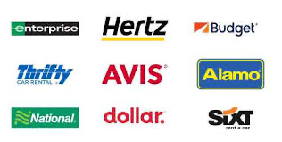
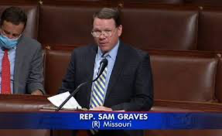
Might a Federal Approach Work?
Extending the Graves Amendment to Limos?
Graves (49 USCS § 30106): Rental/leased vehicle owners cannot be vicariously liable for the vehicle’s negligent operation.
IDEA: Shield limousine companies from vicarious liability for actions of independent contractor drivers?
Audio Visual
Sponsor

Slide 28
Other Ideas for a Federal Approach?
Tie Federal Funding to State Tort Reform?
Withhold federal funding from states that fail to implement targeted tort reforms specifically designed for the limousine and passenger ground transportation industry.
These reforms could include requiring states to mandate telematics to help save lives and reduce insurance costs?
Audio Visual
Sponsor

Slide 29
NLA Limousine Operator Insurance Survey
Insurance Coverage & Costs: Details on insurance providers, length of coverage, average premiums, and premium increases over time – to identify variances and root causes among various cities and states.
Claims Experience: Examines claim history, types of incidents, and reasons for filing insurance claims, and the relationship with insurance premium increases.
Safety Programs & Risk Management: Measures the extent of operator engagement in researching and negotiating insurance options and deploying risk management or safety programs (the spectrum of efforts undertaken by operators to reduce claims and premium costs).
Audio Visual
Sponsor

Slide 30
Industry Perspectives:
Operator
Jason Sharenow
Broadway Elite Chauffeured Services Worldwide
Audio Visual
Sponsor
Coffee Sponsor

Slide 31
Industry Perspectives:
Broker, Insurance, Legal
Andrew Don
COO
Research Underwriters
Tim H. Delaney
President
Lancer Insurance
Matt Daus
Partner and Chairman
Windels Marx
Audio Visual
Sponsor

Slide 32
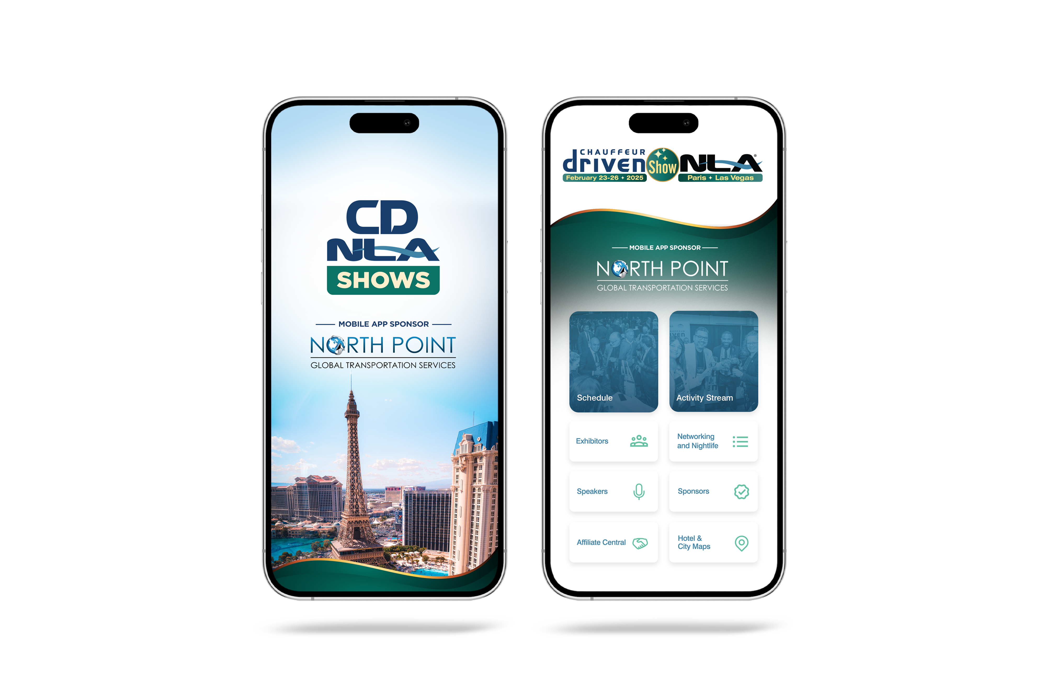
Let Us Know How
We Did!
Fill Out the Survey

Slide 33
Thank You for Joining Us!

